Slide 1




The Inclusion of
Women in Trucking
Notes:
Introduce yourself (include your position in the company and anything of interest you would like to share)
Give the purpose for your presentation. If this presentation (or a version similar) is to be incorporated in your Orientation you may want to note that the purpose of this presentation is to highlight the benefits of diversity in the workplace and to ensure that your company’s culture is welcoming to women. Women make up over 48% of the workforce in Canada, however, less than 14% are represented in road transportation. In non-traditional roles like the professional truck driver, this percentages decreases to 3%.
If you have data on women in your company introduce it here. Also, if you have a corporate goal to increase the representation and advancement of women in your company, introduce it here or add a slide to highlight the data and goals. As your company tries to increase its representation of women in trucking, it is important that everyone understand the facts.

Slide 2

Section Content
Diversity and Inclusion Defined
Benefits and Challenges
Legislation/Legal Considerations
Creating a Welcoming Workplace
Notes:
Read slide.
This is an overview of the presentation.

Slide 3
Definitions
Diversity
The ways in which we differ
Inclusion
The act of including or the state of being included; belonging
Notes:
It is important that employees understand that It is not just about representation or having the numbers. Hiring diverse groups or those who are underrepresented such as women in trucking is only one step. Creating a culture that is inclusive is most important.

Slide 4
Trucking Industry:
Gender Demographics
3% of truck drivers
3% of mechanics, transport trailer technicians, and cargo workers
11% of managerial staff
25% of freight claims and safety, and loss prevention specialists
18% of dispatchers
13% of parts technicians
Notes:
To begin this slide note that Women make up 48% of Canadian workforce but only 14% of people employed in Road Transportation
Follow by reading the slide to highlight the underrepresentation.
These statistics help explain why it is important to increase representation to ensure the trucking company is more representative of the community it serves. It is also important to note that trucking has a skilled labour shortage that is only predicted to become more acute in the next decade. Increasing our representation of women can fill the gaps and improve the industry overall.
Here is another area you can give your company statistics.

Slide 5
Benefits of Diversity and Inclusion
Addresses skills shortages/turnover
Attracts a new customer base
Fosters innovation/creativity
Increases productivity
Positive Reputation
Notes:
Addresses skills shortages/turnover – on this point you can repeat that there are skilled shortages in the industry now and these shortages are forecasted to become more acute in the future. The Canadian truck transportation sector alone is projected to employ 369,000 people by 2021. To meet this demand the sector will require at least 153,000 additional workers, an average of 14,100 per year. The gap between supply and demand for truck drivers could reach as high as 33,000 by 2020 in Canada. It is estimated that the driver shortage will be felt worse in Atlantic Canada due to an aging demographic.
Attracts a new customer base – women are the largest consumer of products and services. Having women involved and/or offering a woman’s perspective can open the company to different markets/customers
Fosters innovation/creativity – when there are diverse viewpoints there is a better opportunity to be creative and avoid “group think”
Increases productivity – When managed properly, diversity can improve productivity with the creation of better processes and systems
Positive Reputation- a diverse and inclusive company becomes not only a place people want to work but also is a company people want to do business with

Slide 6
Challenges of Diversity
Communication Barriers
Stereotypes/Biases
Opposition to Change
Implementation
Managing Diversity
Notes:
Diversity does have its challenges. In order to overcome them, we must recognize them and ensure we are equipped with the tools to overcome them.
Communication Barriers – Everyone has a unique set of beliefs that are shaped by their experiences. Some of the experiences we have are gender specific. This may mean that we interpret or have different reactions to the same events. Understanding this and being open to others viewpoints and actively listening without judgment can help an organization create a respectful workplace for all.
Stereotypes/Biases – To be inclusive we need to challenge our own biases and stereotypes. Women are not as strong as men or not as mechanically inclined are just two such examples. It must be stressed here that the competencies to perform any task in trucking is NOT gender specific.
Opposition to Change – Many people are reluctant to change. Fortunately trucking is dynamic and changing all the time. Making sure people understand the change and the overall benefits to everyone can go a long way to bring the naysayers on side.
Implementation – Sometimes when people have opposing viewpoints it slows down the process from conception to implementation. This slow down, however, can be very beneficial as it allows us to spend the best amount of time in the planning stage to ensure success.
Managing Diversity – Diversity can result in conflict, however, good conflict can result in better creativity and solutions to problems.

Slide 7
Legislation promoting
Equity and Equality
Federally-regulated Employers
The Employment Equity Act
http://laws-lois.justice.gc.ca/eng/acts/E-5.401/
The Canadian Human Rights Act
http://laws-lois.justice.gc.ca/eng/acts/h-6/
Notes:
In Canada, Employment Equity is not only the right thing to do, it is the law. This includes gender equity. What this means and which legislation you are responsible to follow depends upon the jurisdiction under which your company operates.
Ensuring a person’s sex or gender does not interfere with his or her employability, pay and/or advancement is an employer’s responsibility. Employment equity is about hiring, retaining and advancing the best person for the job.
Employment equity DOES NOT mean that women must be afforded special treatment or employment opportunities despite her qualifications or ability. On the contrary, employment equity has been legislated to eliminate employment barriers that have existed and to improve a woman’s access to all occupations including those in trucking that are traditionally male-dominated.
To deny someone employment opportunities for any reason unrelated to ability can be considered discriminatory. Sometimes accommodations must be made to prevent or eliminate discriminatory practices.

Slide 8
Legal Considerations
Employment Equity Act
  Federally-regulated Employers with 100 or more employees
  Must report annual employee data (Labour Program LEEP)Action plans to meet representation for geographical region
Notes:
Equal Opportunity for Employment in Canada is legislated by the Employment Equity Act. As a federally regulated company, you are expected to uphold the principles of this Act by eliminating employment barriers for women and three other designated groups and to increase their representation in workplaces where they have been traditional underrepresented.
Must report annual employee data (Labour Program LEEP)
Total employees in designated and non-designated groups, age, occupation, salaries, promotions, terminations
Action plans to meet representation for geographical region

Slide 9
Legal Considerations
Canadian Human Rights Act
  Applies to all employers federally regulated
  Prohibits discrimination
  Accommodation of Individual Needs (Duty to Accommodate)
Notes:
The Canada Human Rights Commission is a federal organization created to promote the principle of equal opportunity including gender equality. It is empowered under the Canada Human Rights Act to investigate and try and settle complaints of discrimination in employment for organizations and companies under federal jurisdiction.
For more information, please visit: http://www.chrc-ccdp.gc.ca/eng

Slide 10
Grounds for Discrimination
Race
Ethnic Origin
Colour
Religion
Age
Sex
Sexual Orientation
Marital Status
Family status
Disability
Pardoned Conviction
Notes:
Display this slide and note for the purpose of this presentation, SEX/GENDER is grounds for discrimination.

Slide 11
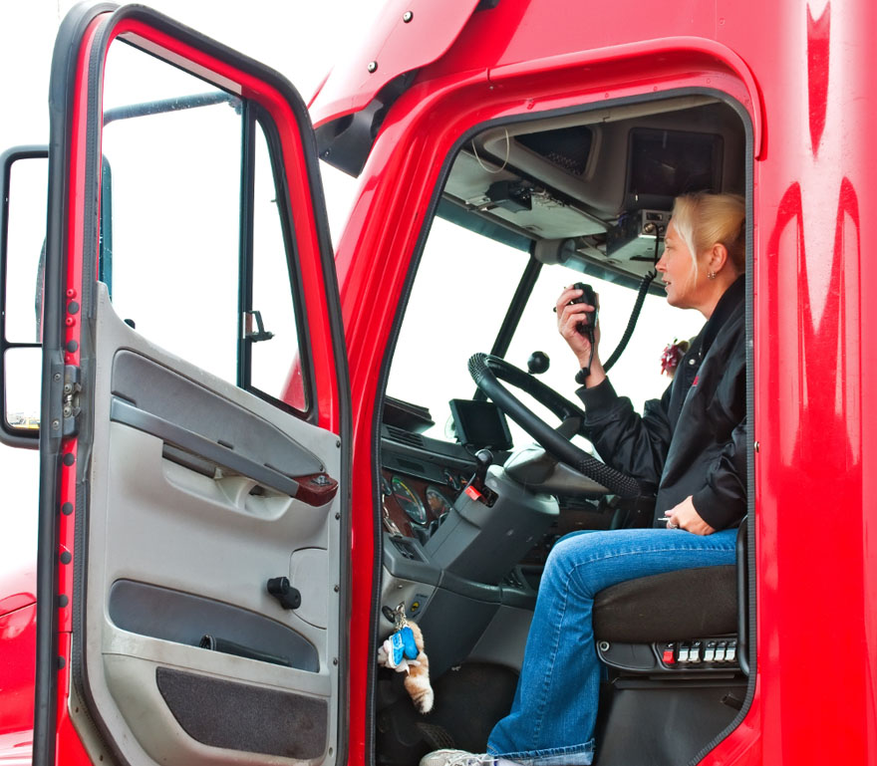
Example of Discrimination
Montreal, Quebec
Company owner refused to hire driver because of gender discrimination
Notes:
HANDOUTS:
Download the following story: http://lawinquebec.com/trucking-company-ordered-to-pay-10000-for-discrimination/

Slide 12
Harassment
Common Discriminatory Practice
    Offends or humiliates (physically and verbally)
    Threatens or intimidates
    Unwelcome remarks/jokes (race, sex, age, etc)
    Unnecessary physical contact
Notes:
Read slide

Slide 13
Sexual Harassment in the Workplace
3 in 10 Canadians say they have been sexually assaulted (28% of the Canadian workforce)
Women are 4 times more likely to be harassed than men.
43% of Canadian women have been harassed in the workplace as opposed to 12% of men.
4 out of 5 sexual harassment incidents at work have gone unreported.
Notes:
Although many may think sexual harassment in the workplace is no longer an issue, the fact is it still very much is despite the advancements made towards equity. The statistics provided is based on an survey conducted in 2014.
Angus Reid Survey. Retrieved from http://angusreid.org/wp-content/uploads/2014/12/2014.12.05-Sexual-Harassment-at-work.pdf

Slide 14
Creating Welcoming Workplaces
Recruitment, Retention and Advancement
Education
Support a Women in Trucking inclusive culture
Harassment–Free and Respectful Workplace Policies
Complaint Reporting and Resolutions
Notes:
This slide is intended to show what your company is doing to welcome women in trucking. Add more initiatives if your company has other things it is doing.
Here is a great opportunity to bring out any policies you have to highlight such as a harassment-free environment/respectful workplace policy, diversity policy and complaint resolution.

Slide 15
Summary
We are committed to a diverse and inclusive workplace
The benefits of women in trucking far outweigh the challenges
It is not only the right thing to do, it is the law!
Notes:
This slide is intended to sum up your main points.

